Slide 1
Semantic analysis
By
Attia Agha

Slide 2
Semantic analysis
Semantic Analysis is the third phase of Compiler. Semantic Analysis makes sure that declarations and statements of program are semantically correct. It is a collection of procedures which is called by parser as and when required by grammar.
Semantics of a language provide meaning to its constructs, like tokens and syntax structure. Semantics help interpret symbols, their types, and their relations with each other. Semantic analysis judges whether the syntax structure constructed in the source program derives any meaning or not.
Both syntax tree of previous phase and symbol table are used to check the consistency of the given code. Type checking is an important part of semantic analysis where compiler makes sure that each operator has matching operands.

Slide 3
Semantic Analyzer:
It uses syntax tree and symbol table to check whether the given program is semantically consistent with language definition. It gathers type information and stores it in either syntax tree or symbol table. This type information is subsequently used by compiler during intermediate-code generation.
Semantic Errors:
Semantic Errors occur when the syntax of the code is correct but there is a logical issue in terms of meaning or behavior, which can only be detected during the semantic analysis phase of a compiler. These errors are related to the correct interpretation and meaning of the program. Below are the types of semantic errors recognized by the semantic analyzer:

Slide 4
Semantic errors
Errors recognized by semantic analyzer are as follows:
Type mismatch
Undeclared variables
Reserved identifier misuse

Slide 5
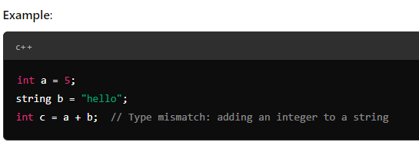
Cont.
1. Type Mismatch
Explanation: This error occurs when two or more incompatible types are used together in an operation. For example, trying to add an integer to a string, or using a function in a context where a value of a different type is expected

Slide 6
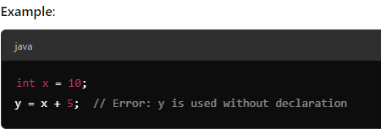
Cont.
2. Undeclared Variables
Explanation: This error occurs when a variable is used in a program without being declared first. The semantic analyzer ensures that all variables used in the code have been properly declared with a valid type

Slide 7
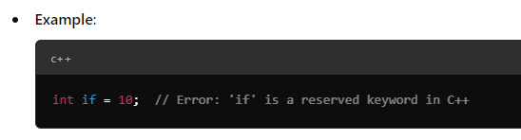
Cont.
3. Reserved Identifier Misuse
Explanation: Some identifiers in a programming language are reserved for specific purposes (such as keywords), and they cannot be used as variable names or identifiers. Misusing reserved words leads to semantic errors.

Slide 8
Cont.
Additional Semantic Errors (Optional):
Apart from the three mentioned errors, here are a few other common semantic errors that semantic analyzers may catch:
Incompatible Function Arguments: Calling a function with the wrong number or type of arguments.
Inconsistent Return Type: Returning a value of an incorrect type from a function.
Out-of-Scope Variables: Using a variable outside its defined scope

Slide 9
Categories
Static and dynamic semantics refer to different aspects of how a program's meaning and correctness are analyzed. These are not specific types of semantics but rather categories based on when and how certain aspects of the program are checked or enforced.
Static Semantics: Static semantics refers to the rules that are checked at compile-time, meaning before the program is executed. These rules ensure that the program's structure and elements (like variable types, scope, or function signatures) adhere to certain constraints and conventions. The term "static" refers to the fact that these checks are done without running the program.
Purpose: While static semantics doesn't define the complete meaning of the program during execution, it ensures that the program adheres to a valid structure that allows it to execute correctly. It focuses on ensuring that there are no semantic errors that could prevent successful compilation.

Slide 10
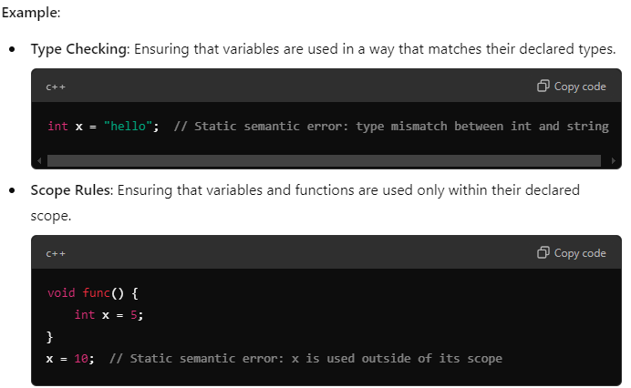

Slide 11
Cont.
2. Dynamic Semantics: Dynamic semantics refers to the rules that are checked at runtime, meaning while the program is executing. These rules define the actual meaning and behavior of the program, such as how expressions and statements affect the program's state as it runs. The term "dynamic" refers to the fact that these checks happen when the program is running.
Purpose: Dynamic semantics deal with the runtime behavior and correct execution of the program. It ensures that operations like function calls, control flow, and memory management are carried out as intended.

Slide 12
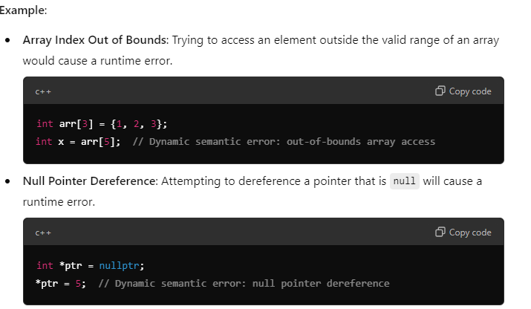

Slide 13
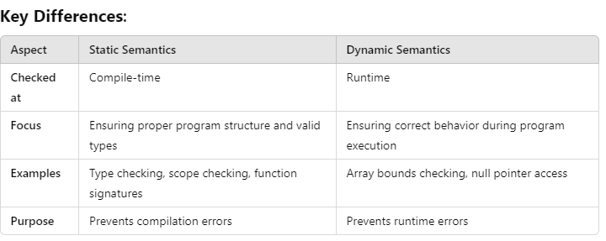

Slide 14
Attribute grammar
Attribute Grammar is an extension of context-free grammar (CFG) where additional attributes are attached to the non-terminals of the grammar. These attributes provide context-sensitive information and are used to specify both the syntax and semantics of a programming language. Attribute grammars help in defining the meaning of constructs in a formal way.
Key Concepts of Attribute Grammar:
1. Attributes:
Attributes provide additional information to the grammar's non-terminal symbols. They are classified into two types:
Synthesized Attributes: These are calculated from the values of attributes of the children nodes (in a parse tree).
Inherited Attributes: These are passed from the parent nodes or siblings to the current node.
2. Domains:
Each attribute has a specific domain of values, which can be simple types like integer, float, string, character, or complex structures like expressions.

Slide 15
Cont.
3. Semantic Rules:
For each production rule in the grammar, semantic rules define how to compute the attribute values. These rules describe how to compute the attributes for a node based on the attributes of its children (for synthesized attributes) or its parent/siblings (for inherited attributes).
4. Attribute Propagation in Parse Tree:
In the parse tree generated by the context-free grammar, the attributes pass values or information between nodes:
Synthesized attributes propagate values up the tree.
Inherited attributes propagate values down or across the tree.

Slide 16
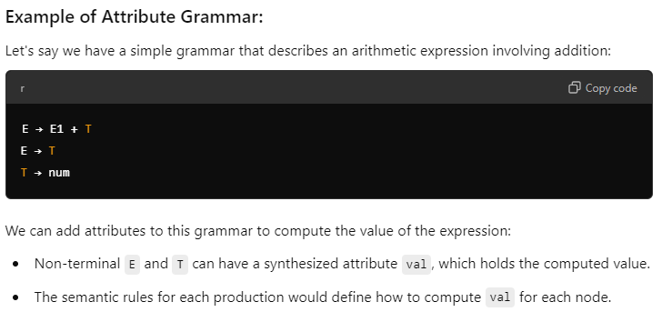

Slide 17
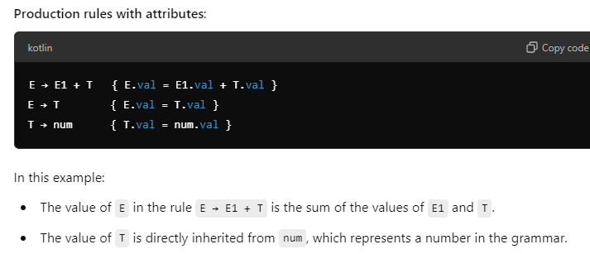

Slide 18
Role of Attribute Grammar:
Semantic Specification: It provides a systematic way to define the semantics of programming language constructs. For example, how expressions are evaluated, or how variables are bound to types.
Context-Sensitive Information: Context-free grammars are limited in capturing context-sensitive aspects (e.g., variable type checking), but attribute grammars can handle such cases by using attributes to store and propagate this context.

Slide 19
Semantic attributes may be assigned to their values from their domain at the time of parsing and evaluated at the time of assignment or conditions. Based on the way the attributes get their values, they can be broadly divided into two categories : synthesized attributes and inherited attributes.
Synthesized attribute
Inherited attribute

Slide 20
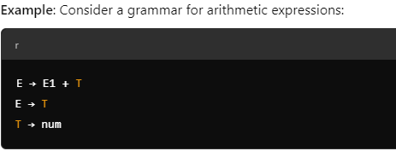
Synthesized Attributes:
Definition: Synthesized attributes are calculated from the attribute values of the children nodes in a parse tree. They allow information to be passed upwards from the children to the parent node.
Usage: Typically, synthesized attributes are used to compute values like expression results, types, or any semantic information that is derived from the parts of a non-terminal (e.g., computing the result of an arithmetic expression).

Slide 21
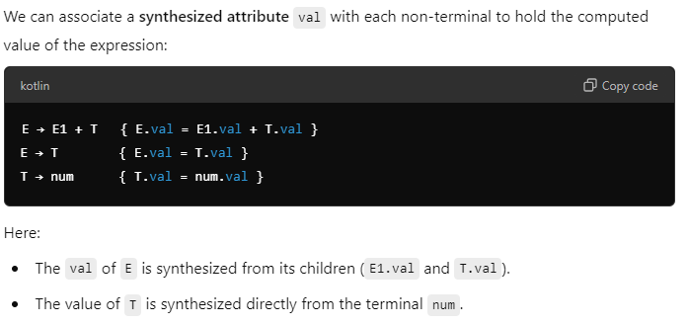

Slide 22
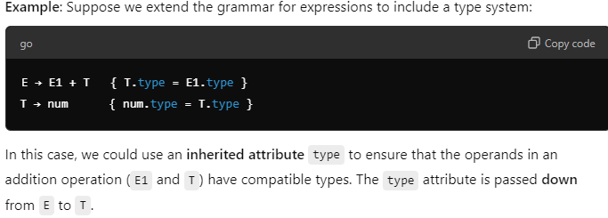
Inherited Attributes:
Definition: Inherited attributes are passed from parent nodes or siblings to the current node in the parse tree. These attributes allow information to flow downwards or across the parse tree.
Usage: Inherited attributes are often used when certain information needs to be passed from an outer context to inner nodes, like types, scope, or environmental conditions that affect the interpretation of a node.

Slide 23

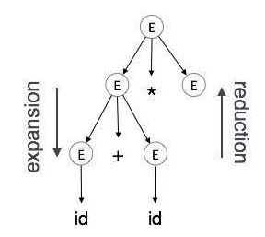
Another example of inherited attribute
As In contrast to synthesized attributes, inherited attributes can take values from parent and/or siblings. As in the following production,
A can get values from S, B and C. B can take values from S, A, and C. Likewise, C can take values from S, A, and B.
Expansion : When a non-terminal is expanded to terminals as per a grammatical rule

Slide 24
Cont.
Reduction : When a terminal is reduced to its corresponding non-terminal according to grammar rules. Syntax trees are parsed top-down and left to right. Whenever reduction occurs, we apply its corresponding semantic rules (actions).
Semantic analysis uses Syntax Directed Translations to perform the above tasks.
Semantic analyzer receives AST (Abstract Syntax Tree) from its previous stage (syntax analysis).
Semantic analyzer attaches attribute information with AST, which are called Attributed AST.
Attributes are two tuple value, <attribute name, attribute value>

Slide 25
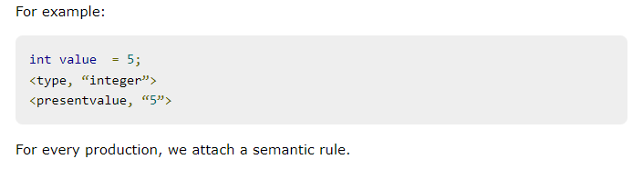

Slide 26
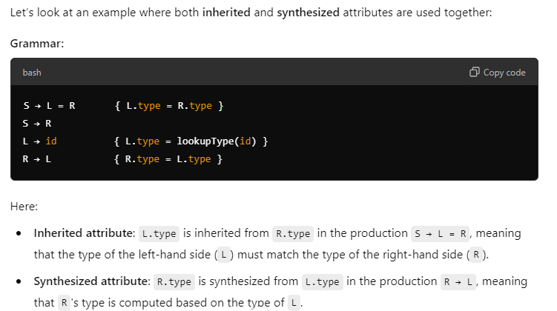
Combined Example of Synthesized and Inherited Attributes:

Slide 27
Summary of Attributes in Grammars
Synthesized Attributes: Information flows upwards from children to parents.
Example: Evaluating arithmetic expressions, type inference from parts.
Inherited Attributes: Information flows downwards or across from parents or siblings.
Example: Passing context, types, or scope information to children nodes.
Attribute Grammar's Role in Syntax-Directed Translation:
These attributes (synthesized and inherited) allow the definition of semantic rules in context-free grammars, ensuring that the parse tree not only checks syntactical correctness but also ensures semantic integrity, such as type consistency, scoping rules, and more.

Slide 28
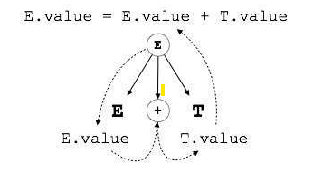
S-attributed SDT
If an SDT uses only synthesized attributes, it is called as S-attributed SDT. These attributes are evaluated using S-attributed SDTs that have their semantic actions written after the production (right hand side).
As depicted above, attributes in S-attributed SDTs are evaluated in bottom-up parsing, as the values of the parent nodes depend upon the values of the child nodes.

Slide 29

L-attributed SDT
This form of SDT uses both synthesized and inherited attributes with restriction of not taking values from right siblings.
In L-attributed SDTs, a non-terminal can get values from its parent, child, and sibling nodes. As in the following production
S can take values from A, B, and C (synthesized). A can take values from S only. B can take values from S and A. C can get values from S, A, and B. No non-terminal can get values from the sibling to its right.

Slide 30
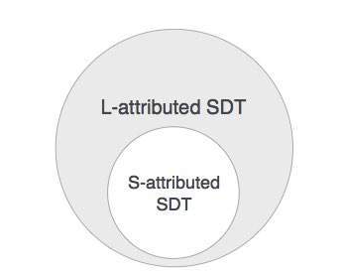
Cont.
Attributes in L-attributed SDTs are evaluated by depth-first and left-to-right parsing manner.
We may conclude that if a definition is S-attributed, then it is also L-attributed as L-attributed definition encloses S-attributed definitions.

